Slide 1
OTP VERIFICATION
Guide Name : Name : Dipak Yadav
Prof.(Dr) Avinash Gupta University Roll No : 2005080100036
HOD CS&E B.Tech(2nd Year ) CS21

Slide 2
INTRODUCTION
The full form of OTP is One-time password. It is a numeric code that is randomly and uniquely generated during each authentication event.
This project of totally depends on python language and library of this language is Pycham which is a editor where we create, read and modify code.
One-time password systems provides a mechanism for logging on to a network or service using a unique password that can only be used once, as the name suggests.
The special Feature of OTP is that Time-based One-Time Password (TOTP) changes after a set period, such as 60 second.
For example : In india, the mAadhar app on my mobile phone allows me to generate a dynamic OTP instead of waiting for a one-time password to arrive. The app’s algorithm generates a dynamic OTP or TOTP. The 8-digit code is valid for 30 second.

Slide 3
OBJECTIVE
The general idea of a One Time Password is to add a second layer of authentication in order to stay ahead of cybercrime and protect your organization against catastrophic effects of fraud on my business.
The risk of fraud is drastically reduced if the user doesn’t only have to fill in his username and password (something he knows) but also needs something he has to complete the login. This ‘something’ can be the user’s phone. OTP’s come in all shapes and sizes, but always add an extra layer of authentication.
The main purpose of OTP is that to make secure our business with other person.

Slide 4
DELIVERY METHOD
There are two main methods for delivery of the OTP is given below :
SMS based :
This is quite straightforward. It is the standard procedure for delivering the OTP via a text message after regular authentication is successful. Here, the OTP is generated on the server side and delivered to the authenticator via text message. It is the most common method of OTP delivery that is encountered across services.
Application based :
This method of OTP generation is done on the user side using a specific smartphone application that scans a QR code on the screen. The application is responsible for the unique OTP digits. This reduces wait time for the OTP as well as reduces security risk as compared to the SMS based delivery.

Slide 5
OTP VERIFICATION
We can easily create an application for the task of OTP verification using Python by following the steps mentioned below :
First, create a 6-digit random number.
Then store the number in a variable.
Then we need to write a program to send emails.
When sending email, we need to use OTP as a message.
Finally, we need to request two user inputs :- first for the user’s email and then for the OTP that the user has received.
So this is the complete process of creating an OTP verification application using Python.

Slide 6
REFERENCE
The reference of this project has been taken from several sites. These reference played a vital role in finding key points and gave an important idea that how this project can be further carried out. It is give better by me. There are some sites given below :
https://thecleverprogrammer.com/2021/04/14/otp-verification-using-python/
https://en.wikipedia.org/wiki/One-time_password
You Tube Video lecture

Slide 7
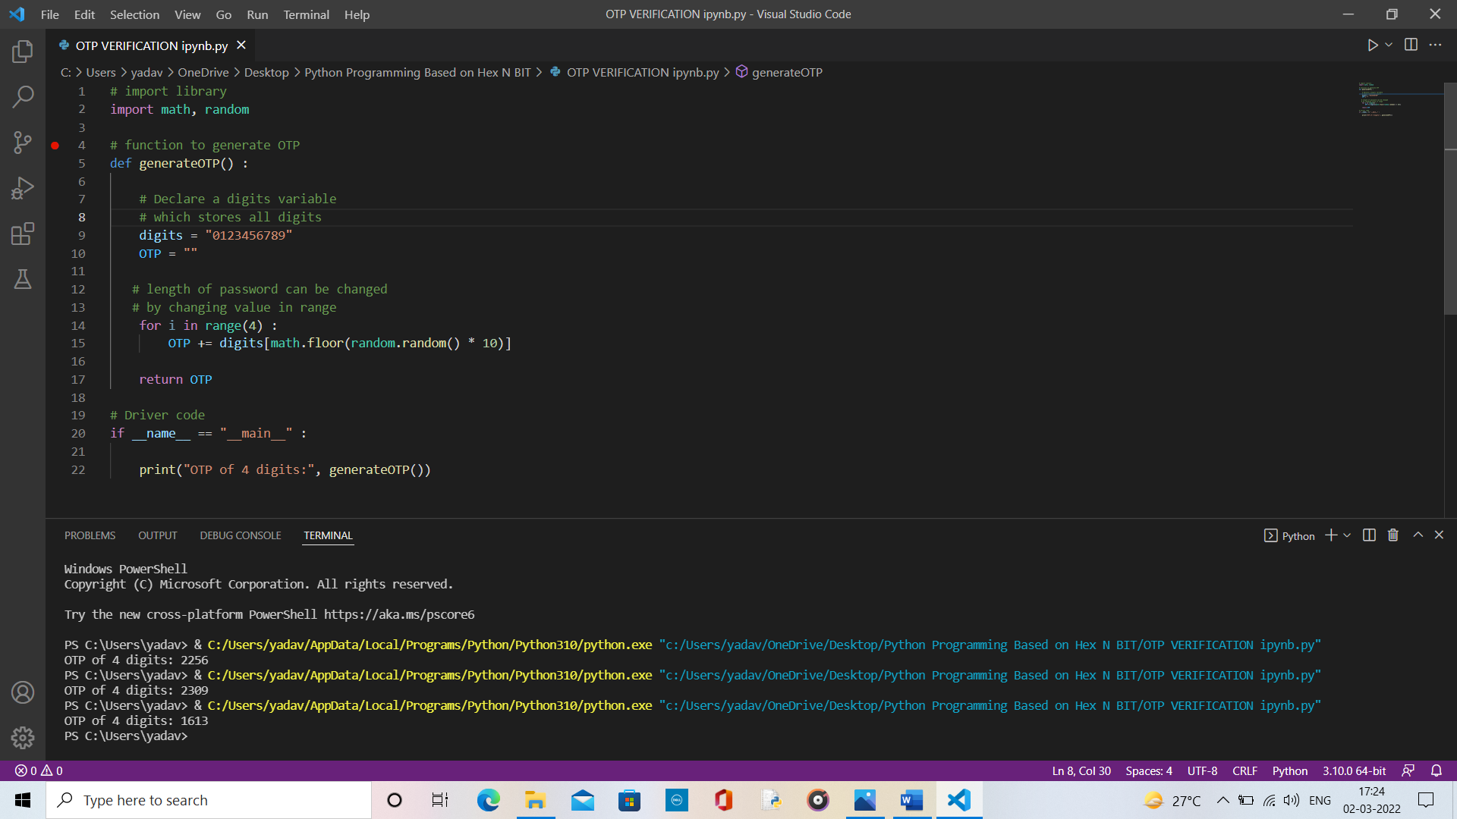
COADING

Slide 8
SYSTEM REQUIREMENTS
Hardware Requirement
i3 processor system or higher
4GB RAM or higher
100GB ROM or higher
Software Requirement
Windows 7 or higher
Python (Programming Language)
VS Code

Slide 9
PROJECT WORK COMPLETED
There are some topic are given below of my project which is completed by me :
Synopsis
OTP Delivery method or Modules
OTP Verfication method
Coading

Slide 10
Thank You

